Slide 1
CloudBox
Nicu-Serban POP
Polytechnic University of Timisoara
3rd Year CTI-EN

Slide 2
Summary
Introduction
Cloud Architecture
Software Implementation
Transfer Protocols
Flowcharts
Using the website

Slide 3
Introduction
The application is a cloud based platform for storing files online. You can upload, download and delete any of your files. You can add multiple files with the same name as the website will automatically rename your file adding a number between brackets ((1), (2) etc.) just like Windows.
In order to do all of this you need an account that is very easy to create by providing username, password and an email for password recovery just in case you forgot it.

Slide 4
Introduction
Why use cloud? For some computer owners, finding enough storage space to hold all the data they've acquired is a real challenge. Some people invest in larger hard drives. Others prefer external storage devices like thumb drives or compact discs. Desperate computer owners might delete entire folders worth of old files in order to make space for new information. But some are choosing to rely on a growing trend: cloud storage.

Slide 5
Introduction
The purpose of this presentation is to highlight how our application works without going into too much detail into the hardware and software specifications .
For more information , check our full documentation about the project .

Slide 6
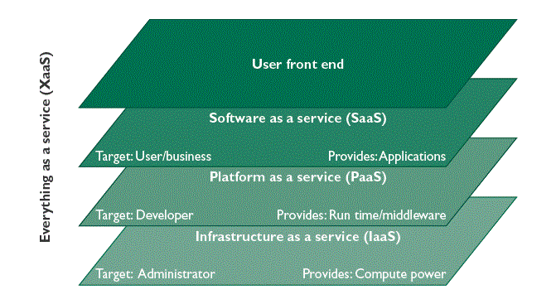
Cloud Architecture
This is the basic architecture of a cloud-based platform. In our case we use them as follows:
User front end: the website.
Software as a Service: the webserver (Apache).
Platform as a Service: the operating system (Raspbian).
Infrastructure as a Service: the Raspberry Pi with all its components.

Slide 7
Software Implementation
The website is a fusion of PHP, HTML, CSS, JavaScript, shell scripts, C scripts and MySQL databases.
The website is run under the Apache Server. It is a software that allows entities to host web servers, mail servers etc.
The databases containing user and files information are stored under a MySQL server and managed by the phpMyAdmin platform.
File moving and deletion is done by terminal command run on the web server.
Design is build using HTML, CSS and JavaScript.
Email server using Simple Mail Transfer Protocol (SMTP) to send mails.

Slide 8
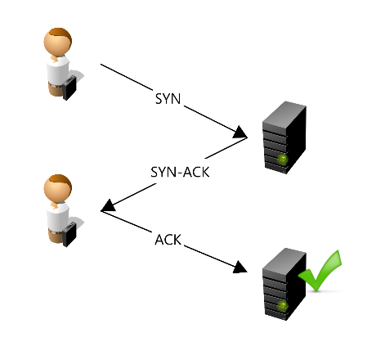
Transfer Protocols
TCP (Transmission Control Protocol)
Provides a communication service at an intermediate level between the administrators of the server and the server.
Transmission Control Protocol accepts data from a data stream, divides it into chunks, and adds a TCP header creating a TCP segment. The TCP segment is then encapsulated into an Internet Protocol (IP) datagram, and exchanged with peers.
Used with programs such as PuTTY.
Requires IP, port, username and password.

Slide 9
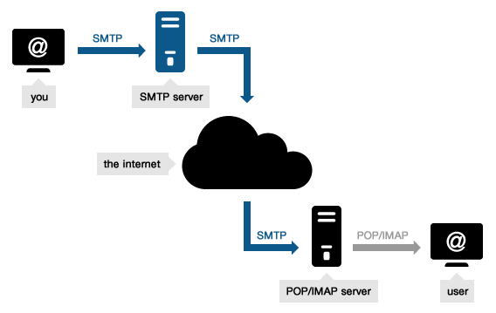
Transfer Protocols
SMPT (Simple Mail Transfer Protocol)
It is an internet standard for email transmission.
SMTP is a delivery protocol only.
Used by the server to send forgot password and feedback emails.

Slide 10
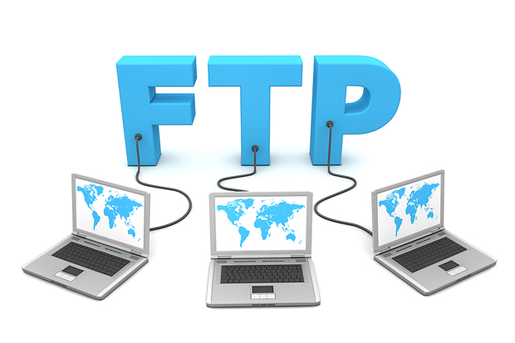
Transfer Protocols
FTP (File Transfer Protocol)
Used to transfer computer files from one host to another host. (administrator <-> server) over a TCP-based network (a.i. internet).
FTP is built on the server and uses separate control and data connections between the client and the server.
Used with programs such as FileZilla in order to manage files (upload/download) remotely with the server.
Requires IP, port, username and password.

Slide 11
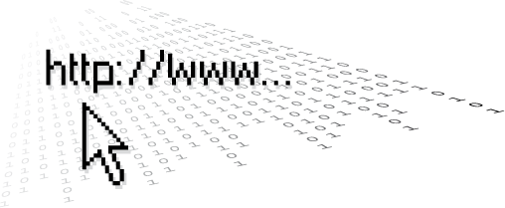
Transfer Protocols
HTTP (Hypertext Transfer Protocol)
Is an application protocol for information systems and the foundation of data communication for the World Wide Web.
HTTP functions as a request-response protocol in the client-server computing model.
HTTP is a protocol used mostly for browsing the internet.
The user (browser) is the client and the Raspberry PI is the server.

Slide 12
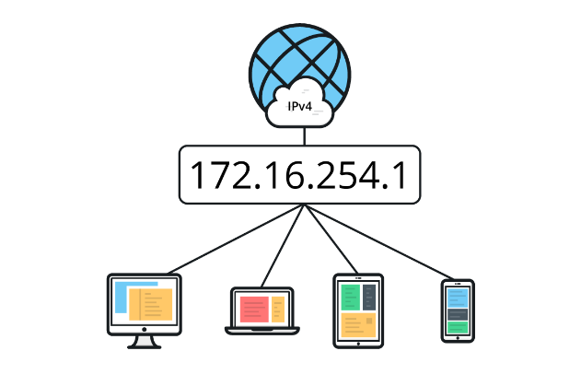
Transfer Protocols
IP (Internet Protocol)
Is the principal communications protocol in the Internet protocol suite for relaying datagrams across network boundaries.
Has the task of delivering packets from the source host to the destination host solely based on the IP addresses in the packet headers.
Defines packet structures that encapsulate the data to be delivered.

Slide 13
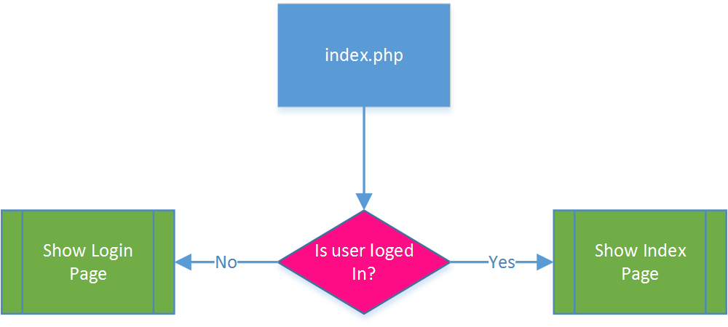
Flowcharts
Following are displayed basic flowcharts of the website pages. Numbers written in red between brackets are error codes as listed in section 10 of the documentation.
index.php

Slide 14
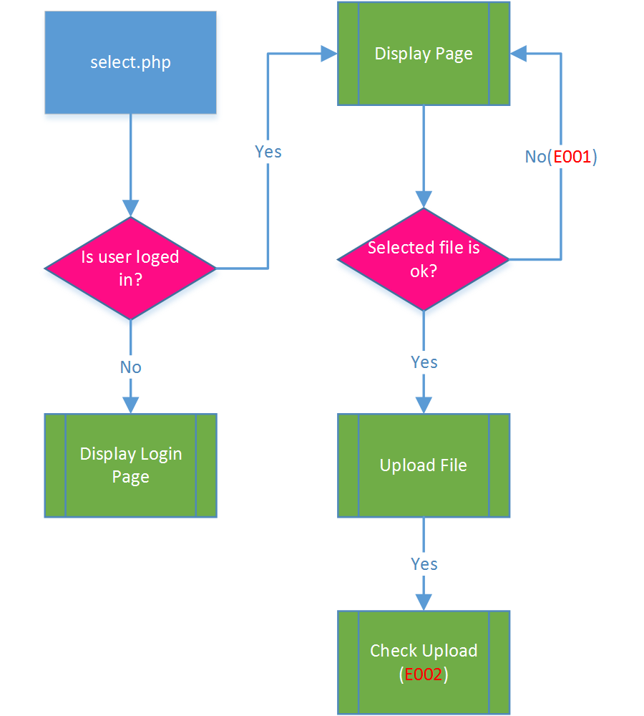
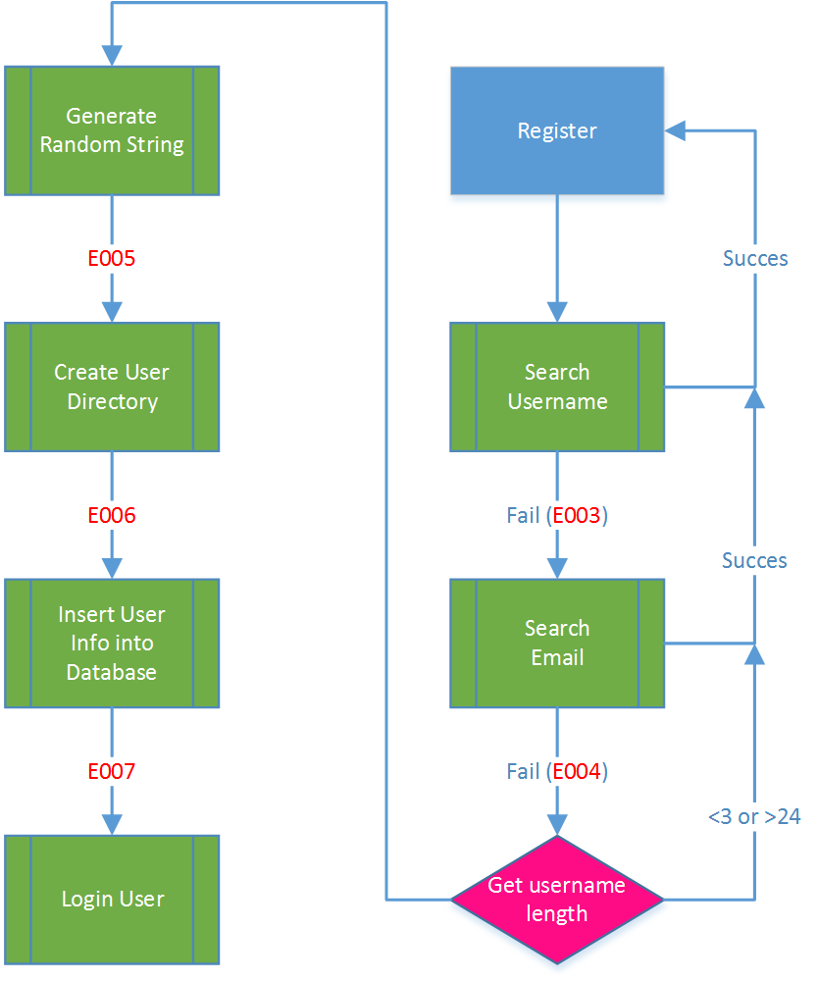
Flowcharts
select.php
register.php

Slide 15
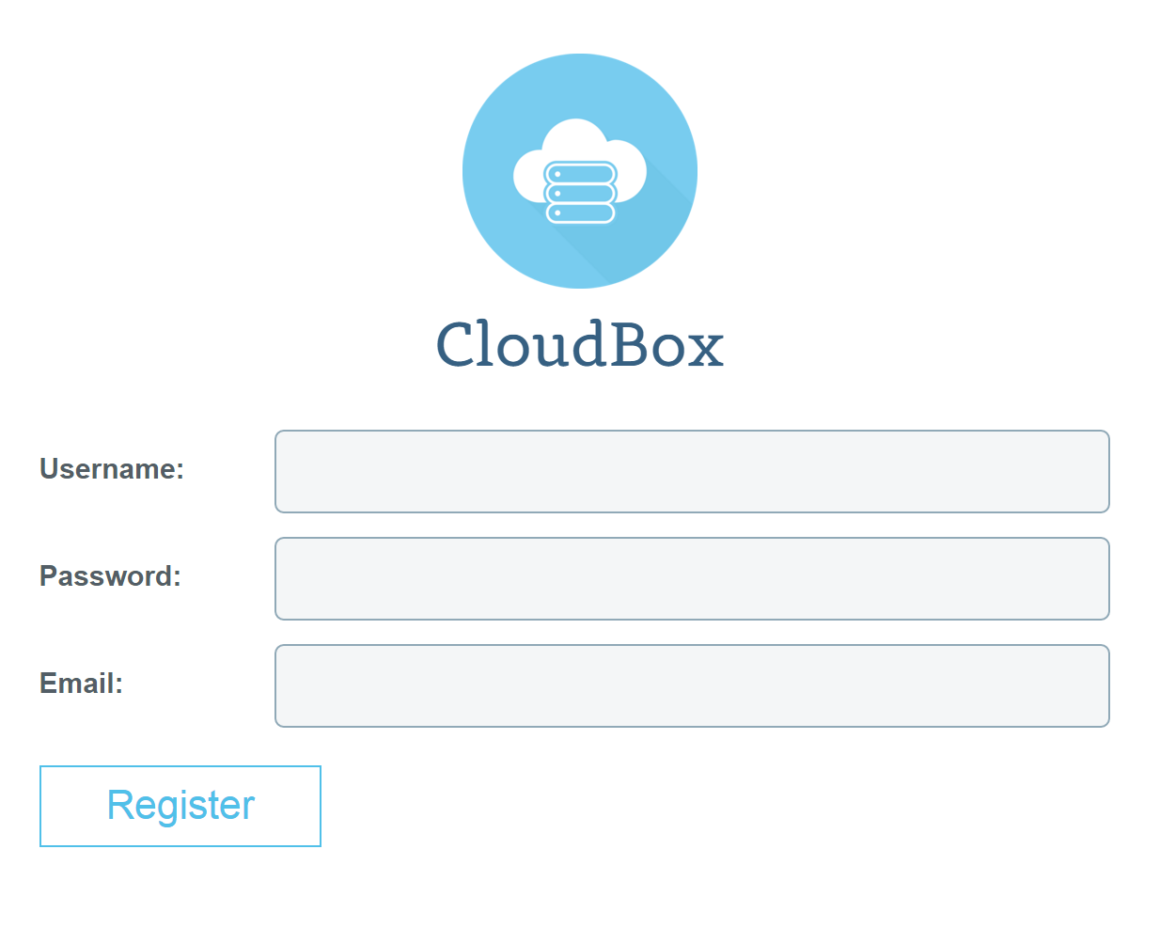
Create an account

Slide 16
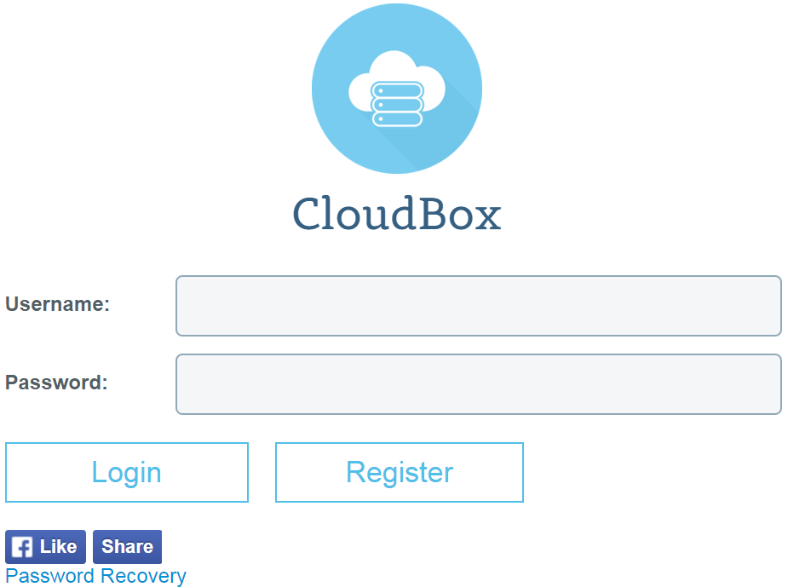
Login into your account

Slide 17
Menu Clarification
Main Page – here you can see brief statistics of your account, leave a feedback for the website creator and the option to logout of the account.
My Files – page containing all of your files.
Upload a File – page where you can upload new files.
File Status – here you can see all the statistics about your files.

Slide 18
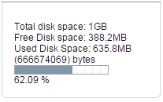
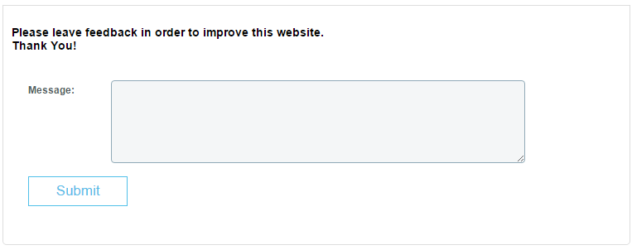
Main Page
Storage info:
Login status:
Feedback

Slide 19
My Files
Brief statistics of storage usage. [left container]
Number of files in each category. [left container]
Files are organized in categories.
File download/view option.
File delete option.
File size on storage, in human format (KB,MB etc.)
Logout button.

Slide 20
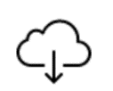
Manage your files
Automatic file organization
Download a file
Delete a file
Size of each file.
Number of files in each category

Slide 21
Upload a file
User upload limit (initially 1GB). Can be changed by any administrator.
Extension filtering for security reasons
On page uploading progress bar:

Slide 22
File Status
Total disk usage.
Free disk space.
Used disk space.
Last uploaded file + download link.
User-friendly free/used space proportion bar.
Number of files in each category.

Slide 23
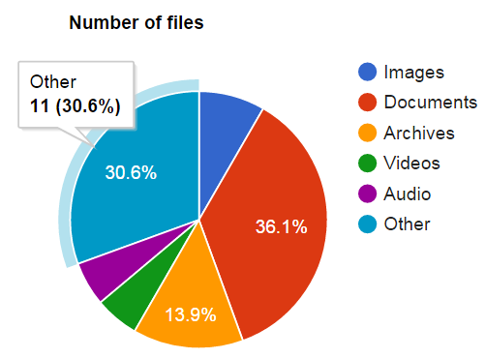
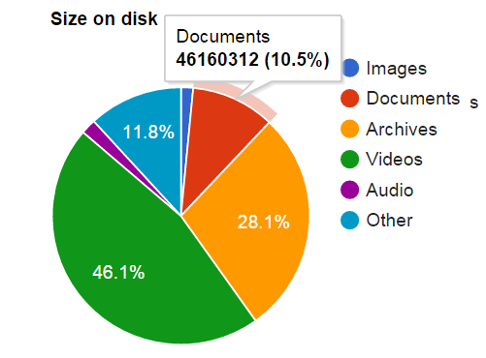
File Status
Number of files in each category in responsive chart.
Size of files in each category in responsive chart.

Slide 24
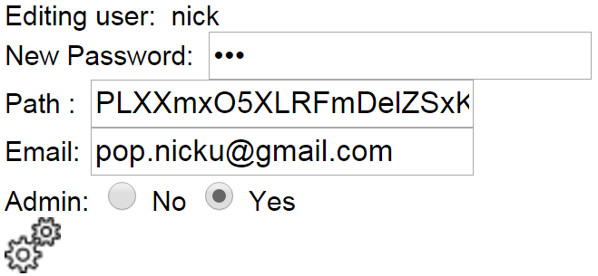
Admin
See total number of registered users.
Start the LCD program:
Change user limitations for uploading files

Slide 25
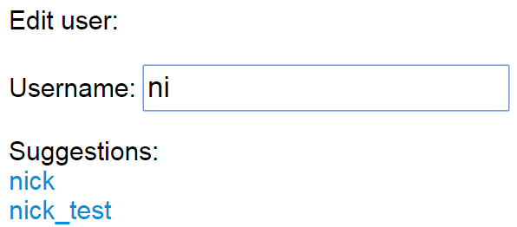
Admin
Edit users with intuitive suggestions (insert part of name and get a list containing all the names starting with that part).
Change password
Change directory path
Make admin.

