Slide 1



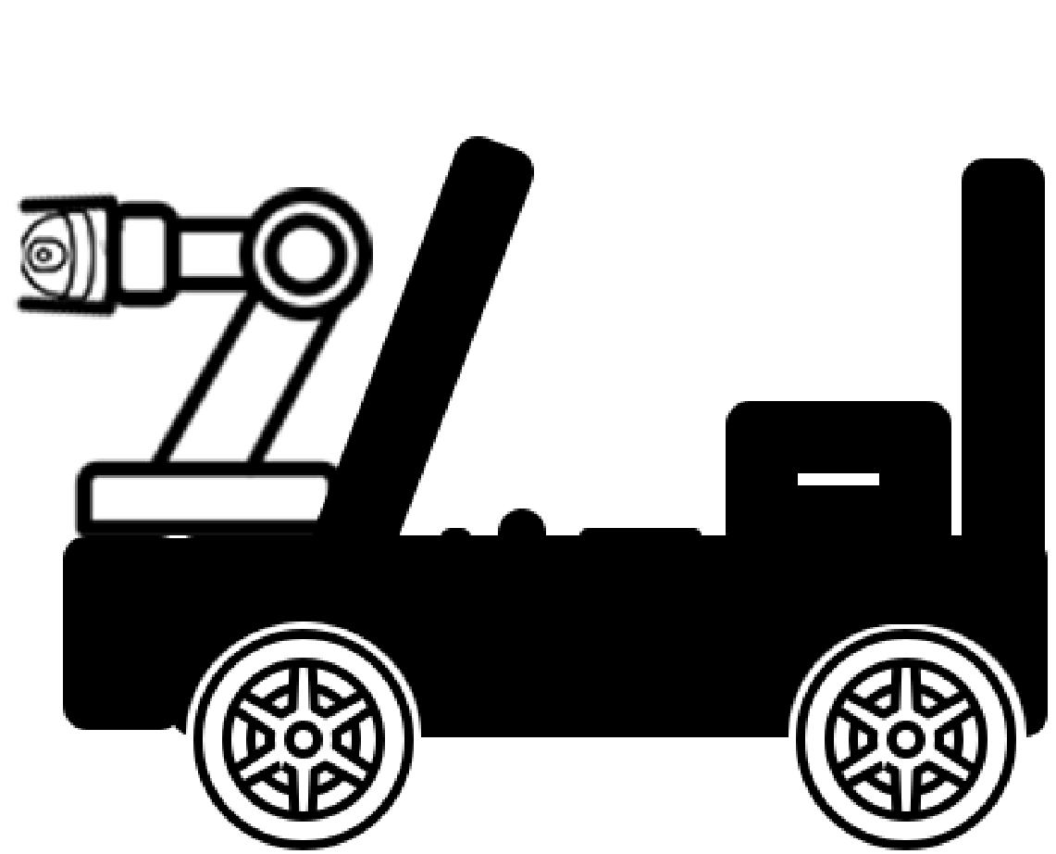

Study of UV-C Intensity Distribution
Using the TIAMO-C6 Sensor
Student: Nicu-Serban POP
Supervisor: Șl. dr. eng. Raul Ciprian IONEL
Politehnica University Timisoara
Notes:
Hello, My name is Nicu-Serban POP and today i'm presenting you a Study of UV-C Intensity Distribution Using the TIAMO-C6 Sensor, which is a measurement application designed to evaluate ultraviolet-C (UV-C) intensity generated by commercially available lamps.

Slide 2


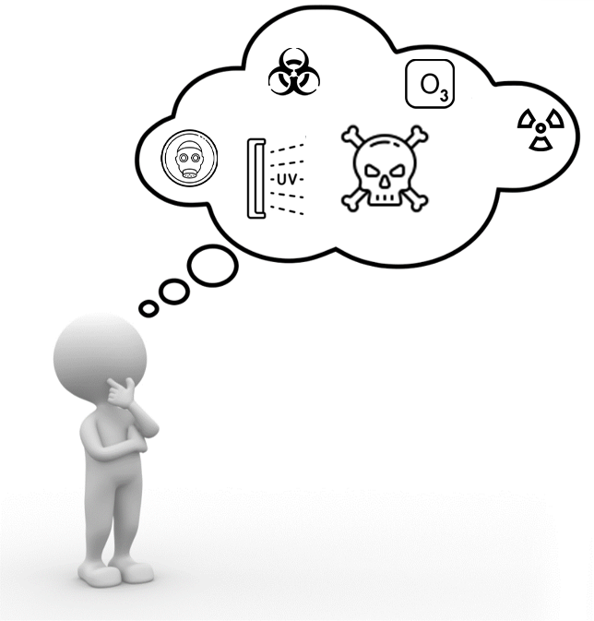
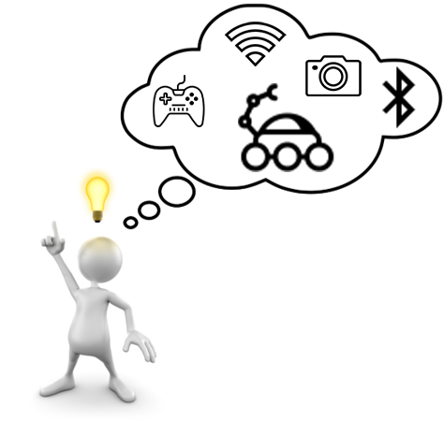


Intro
Notes:
UV-C which has a wavelength of 200-280nm is widely used in disinfting area of viruses and bacteria. The problem is, its dangerous for human beings because of the UV radiation and ozone produced and is considered a potential human carcinogen.
We designed a remotely controlled vehicle that can explore areas exposed to UV-C light where human presence is not allowed. The vehicle will be able to be controlled from a distance and have a video feedback.

Slide 3

Overview of the proposed system
Four driving motors
Two servo motors
2 Remote Controllers
Wireless Communication
High-accuracy UV-C Sensor
Cloud Data
Video Feed
Notes:
The vehicle comes with 4 independent wheels with one motor each that can be driven individually and can be controlled by two different remote controllers.
The vehicle will be able to transmit video trough the video camera attached to it's head. This head contains two servo motors in order to allow it to bidirectionally move.
The Raspberry Pi centralizes and controls devices such as the video camera, the driving motors and the Bluetooth controller while the Arduino Nano is responsible for reading the analog values from the sensor-module,
For driving the servo motors and for communication with the wireless controller.

Slide 4
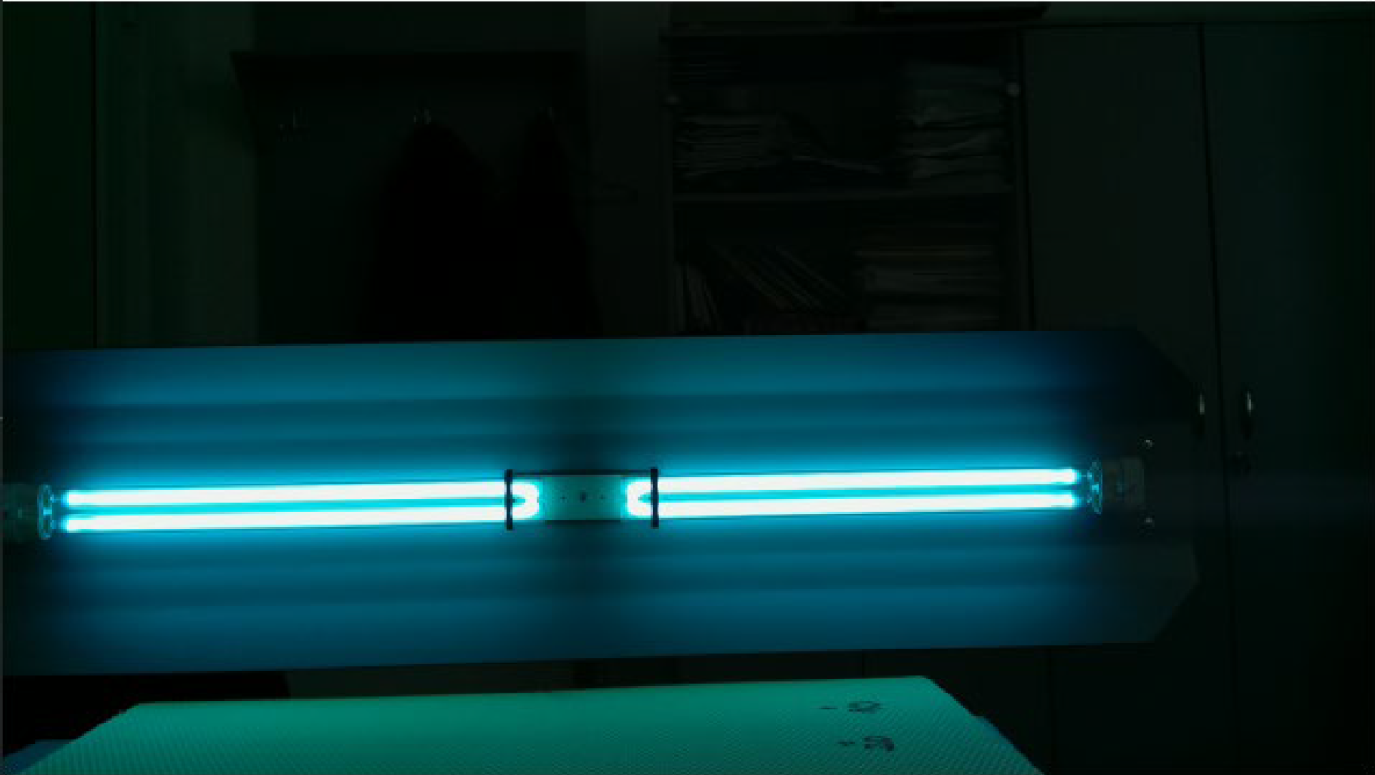
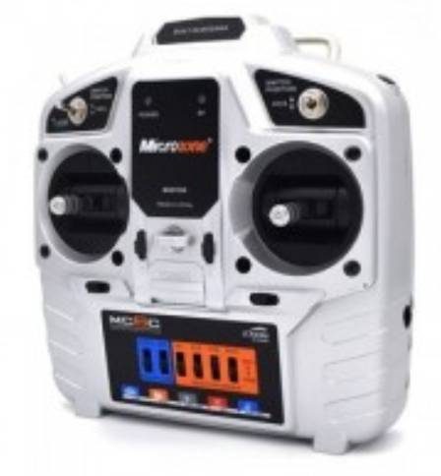
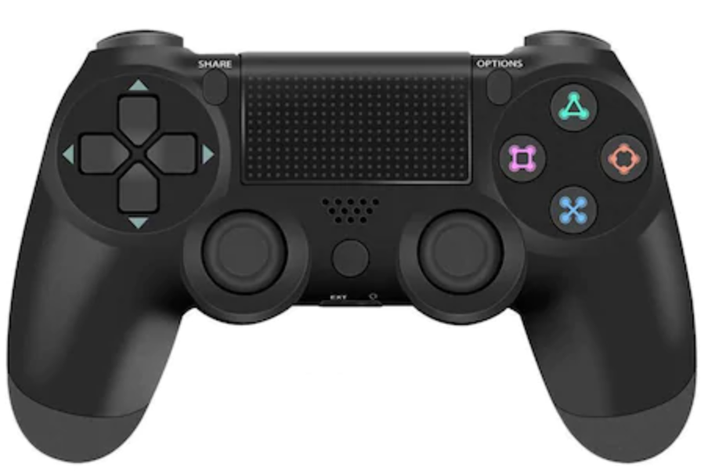
Control & User Interface
Video Feed
DS4
MC6C
1920x1080 resolution
Video delay: 20~80ms
25Mbps bitrate
Bluetooth
Higher Accuracy
Up to 10 meters
Wireless
Lower Accuracy
Up to 1000 meters
Notes:
The wireless controller is a drone controller (MC6C) that is capable of transmitting up to 1km in the best case scenario but is not as accurate as the Bluetooth one and requires a special receiver. This type of controller can be seen in the right most part of the screen.
The other type of controller for the vehicle is a PlayStation 4 DualShock controller. It communicates via Bluetooth and has a better accuracy than the drone controller but has a significantly lower range of up to 10 meters and is shown in the middle of the screen.
In the left part, a screenshot from the live video feed is shown and is exactly what the users sees.
The video has a resolution of 1920x1080 with a delay between 20 to 80ms but can go higher depending on wireless obstacles or interference.

Slide 5
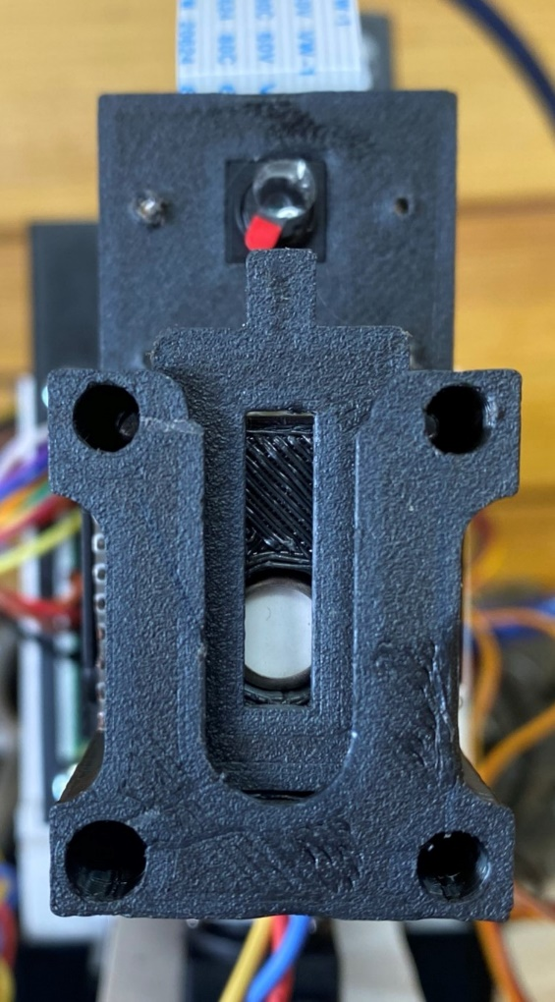
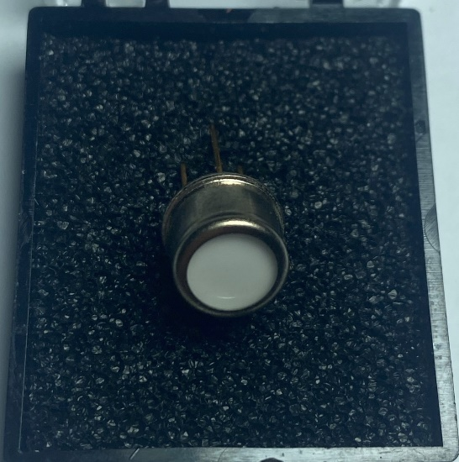
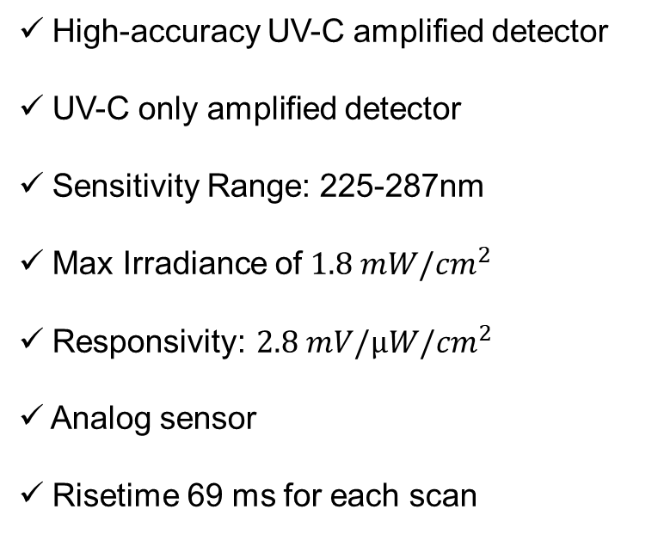
Sensor-module
High-accuracy UV-C amplified detector
UV-C only amplified detector
Sensitivity Range: 225-287nm
Max Irradiance of $1.8 mW/{cm}^{2}$
Responsivity: $2.8 mV/µW/{cm}^{2}$
Analog sensor
Risetime 69 ms for each scan
UV-TIAMO-C6 Sensor
Notes:
Going back to our sensor, we are using a TIAMO-C6 amplified detector from Roithner LaserTechnik.
It is capable of reading UV light in the range of 225-287nm wavelength.
It can detect UV light up to a maximum irradiance of 1.8mW/cm2 which is achieved from 95% of supply voltage 3.3 or 5V in our case and has a responsivity of 2.8 𝑚𝑉/µ𝑊/𝑐𝑚^2 and takes around 69ms to read one sample.
The naked sensor is shown in the left image while in the right image is the sensor with its 3D printed protective enclosure.

Slide 6
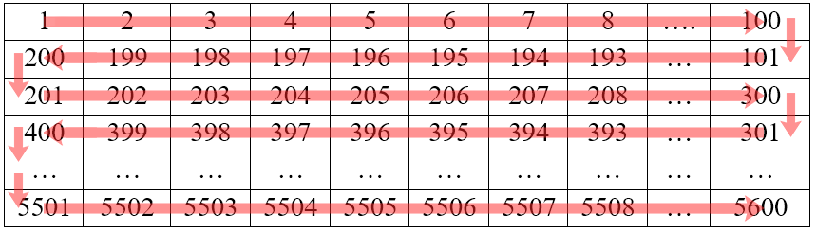

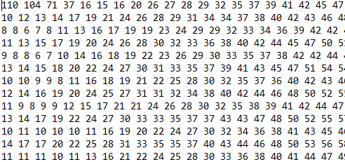
Measurement Data
2D Matrix traversal ⬄ 2D scanning
100x56 resolution
5600 points scanned
Data File Sample
Notes:
One of the main features of the robot is the ability to produce a 2D matrix grid with UV data, dispersion map. In order to do this, the robot's head will move in a grid-like pattern as shown in the upper left image. The resulting grid will have a resolution of
100x56 and this is in order to have the same aspect ratio as the camera/photo of 16:9. This gives us a total 5600 readings.
The data that is collected contains values between 0-1023 with higher values having higher intensity and a data sample is shown in the lower right part of the screen.
A typical result of this type of measurement is shown in the lower left part of the screen where you can see the UV outline.

Slide 7
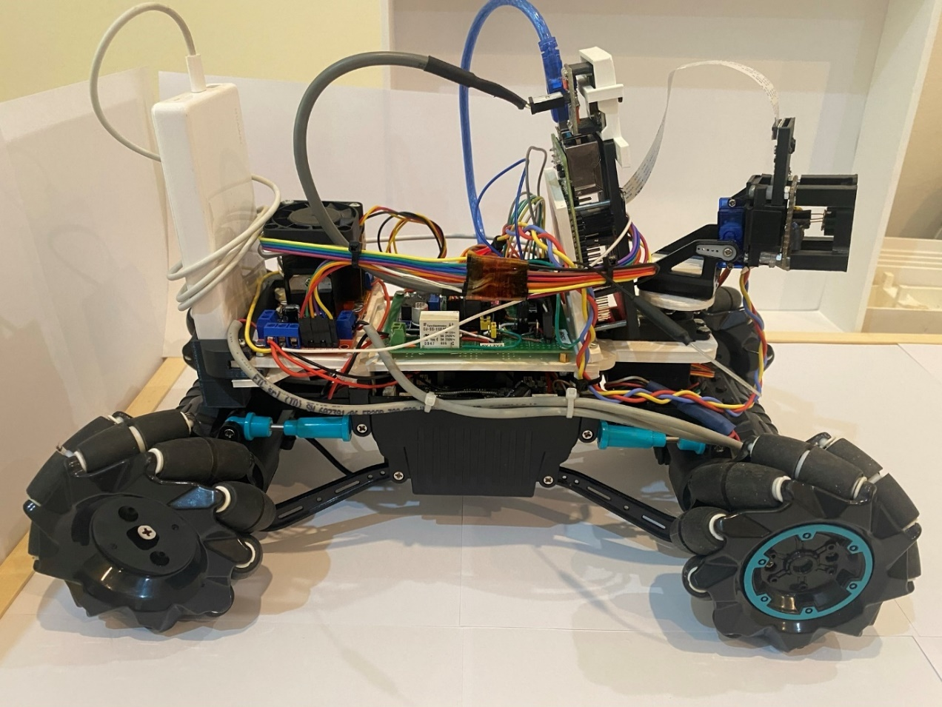
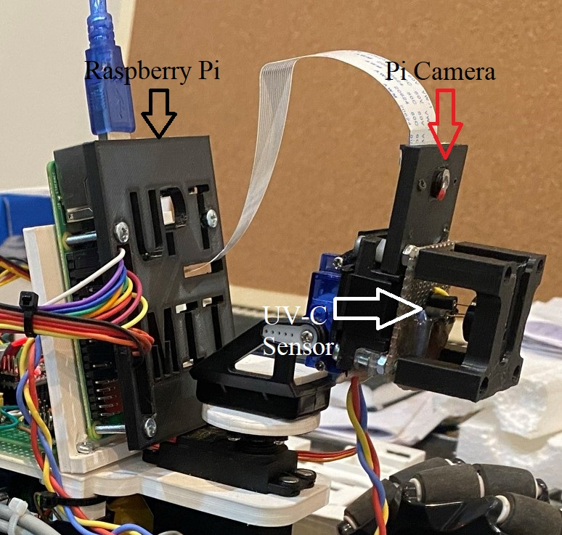
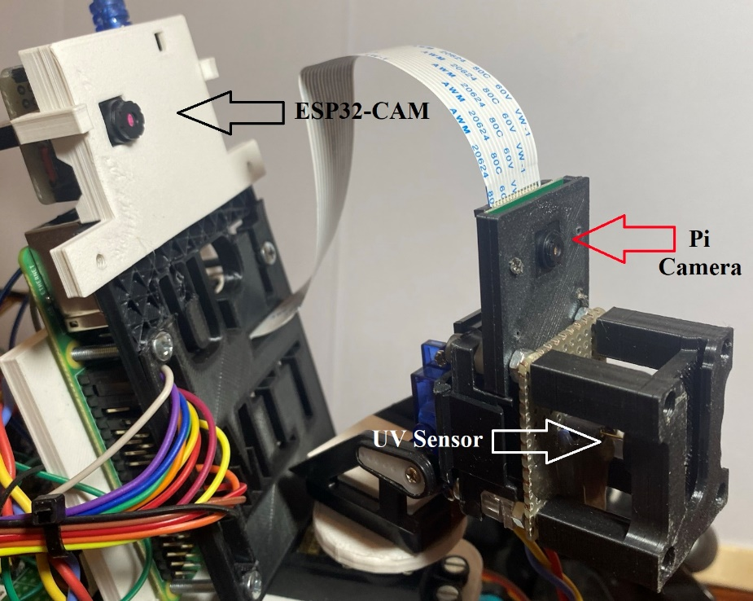
Working Prototype
Notes:
Before continuing to the actual test results, this is how the vehicle looks. A side view of the entire vehicle shown in the right image and its head in the left image containing the cameras and the UV-C sensor module in its protective enclosure.

Slide 8
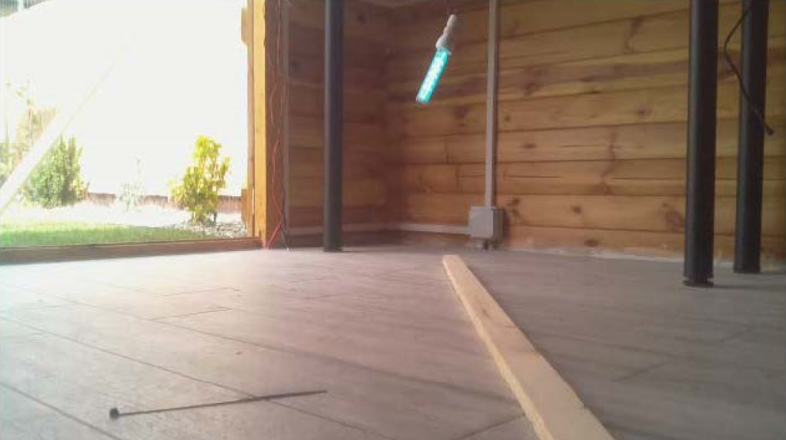
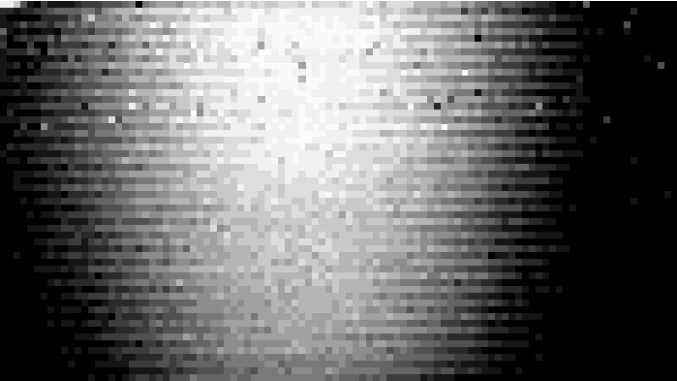
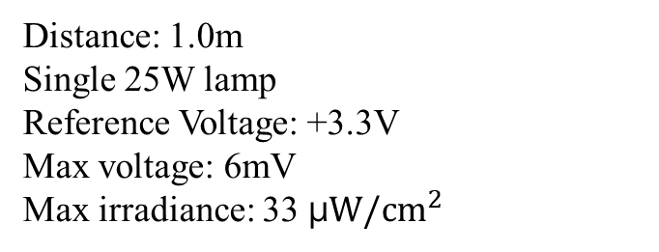
Test Results
Distance: 1.0m
Single 25W lamp
Reference Voltage: +3.3V
Max voltage: 6mV
Max irradiance: 33 μ$W/{cm}^{2}$
Notes:
For our test data, here we can see in the upper left part of the screen the testing environment that we used. The UV lamp can be seen in the middle upper part of the image in light blue.
The resulting matrix grid is shown in the right side of the screen and the UV radiation outline can be noted.
This test was done with a single UV lamp of 25W from a distance of 1 meter and we achieved a maximum irradiance in the middle of the UV blob of 33uW/cm2. Our reference voltage in this case was 3.3V

Slide 9

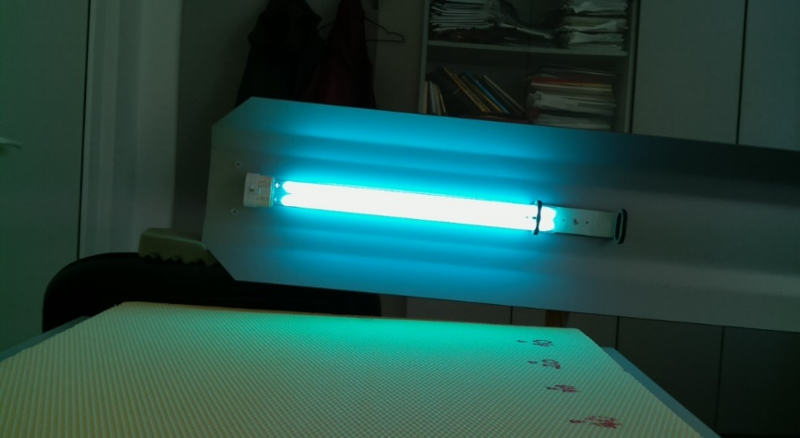
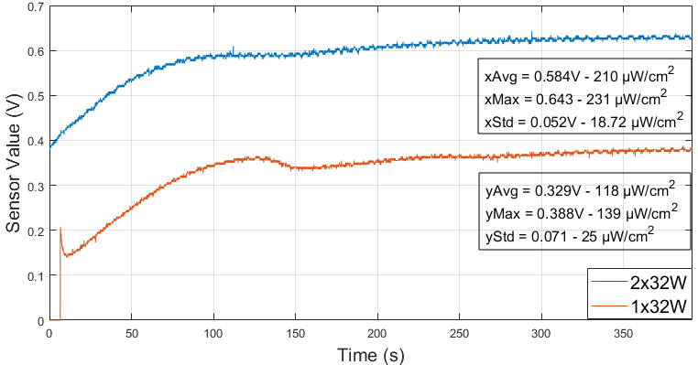
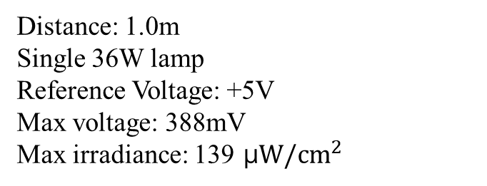
Test Results
Distance: 1.0m
Single 36W lamp
Reference Voltage: +5V
Max voltage: 388mV
Max irradiance: 139 μ$W/{cm}^{2}$
Notes:
In our 2nd testing scenario, we used a single 36W lamp from a distance of 1 meter. The UV lamp was turned off before starting to collect data.
In this chart the resulting data from one 36W lamp and two 36W lamps are compared. The data that is present on the chart were acquired using single point measurement mode (without moving the head). It can be noted from the chart that, after being turned on,
the sensor and the lamp need about 200 seconds to warm-up and after that the matrix grid can be generated as seen in the right image.
In this scenario, we achieved a maximum irradiance of 139 μW/cm2 in the middle of the UV blob for one lamp and 231μW/cm2 for two lamps.

Slide 10
Contributions & future development
Research on UV-C disinfection devices and tools;
Vehicle and sensor module implementation
Programs written in: C (Arduino), python (RPi), MatLab (data processing);
2D Matrix-grid implementation;
Video feed implementation;
Experimental measurements for 1x36W, 2x36W, 1x25W commercial UV-C lamps;
Submission of paper abstract at SIITME 2021, WoS Indexed Conference.
As future development: correlating the effectiveness, in relation with exposure time,
distance and target colonies type.
Notes:
My contribution to the actual scientific paper include research on UVC disinfection devices, vehicle and sensor design and implementation
with everything included, the hardware and the software (written in C for the arduinos sensor and stepper motors, the python core
script that centralizes everything and matlab for data processing) and also a bit of java processing for the matrix grid.
I also did the testing on two different types of lamps and submitted the paper abstract to SIITME 2021.
As future development, we aim on correlating the effectiveness of a disinfection device, based on such UV-C lamps, in relation with exposure time, distance and target colonies type.

Slide 11
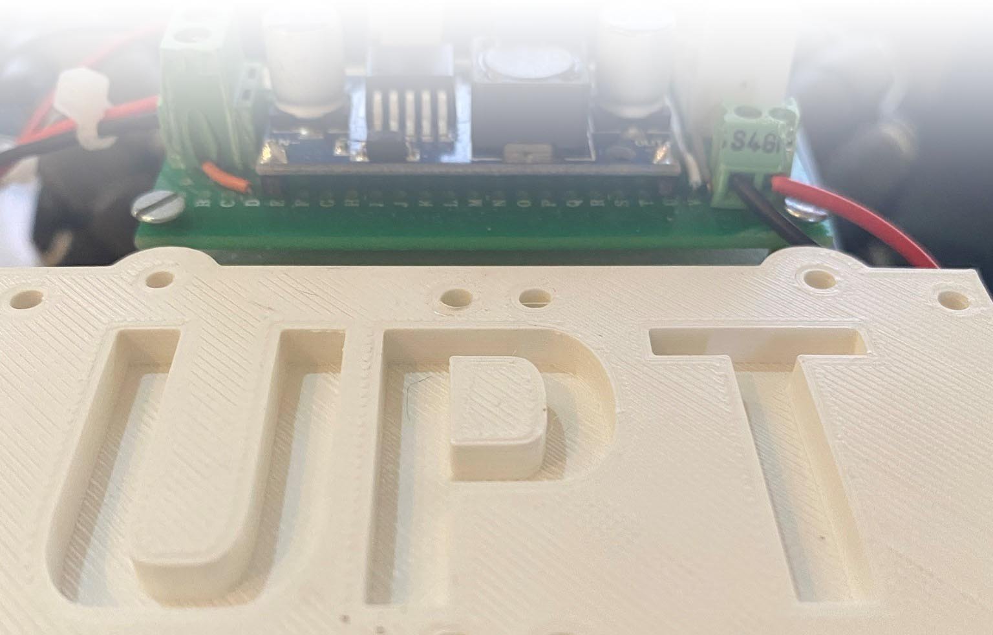
Thank You!
Notes:
Thank you, if you have any question please ask but I also have a video presenting the vehicle itself if you want to see it.

